Slide 1
Combinational Circuits
Oleg Ladin
21 September 2020

Slide 2
Layers of Abstraction in CS
Application
Algorithms
Programming Language
Operating System
Instruction Set Architecture
Microarchitecture
Gates/Register-Transfer Level (RTL)
Topics of
this lecture
Circuits
Physics

Slide 3
Boolean operations: Inversion
NOT (Inversion)
2 MOSFET
1
Vcc
x | !x
0 | 1
1 | 0
x
!x
x
Output
0

Slide 4
Boolean operations: AND & OR
AND (or Boolean multiplication)
NAND
OR (or Boolean addition)
NOR
x | y | x*y
0 | 0 | 0
0 | 1 | 0
1 | 0 | 0
1 | 1 | 1
x | y | x+y
0 | 0 | 0
0 | 1 | 1
1 | 0 | 1
1 | 1 | 1
x
x
x*y
x+y
y
y
4 MOSFET
4 MOSFET
Vcc
Vcc
1
1
A
B
Output
Output
x
A
x
!(x*y)
!(x+y)
y
B
y
0
0

Slide 5
Boolean functions
Boolean operations can be combined into functions
F(x,y,z) = x + !y*z
x
x + !y*z
x | y | z | F
0 | 0 | 0
0 | 0 | 1
0 | 1 | 0
0 | 1 | 1
1 | … | … | 1
y
0
z
1
0
0

Slide 6
Combinational Circuits

Slide 7
Combinational Circuits
If the output of a function is completely defined by the current input then the function is called combinational :
Qt = F(xt, yt, zt, …)
A lot of things can be implemented using combinational circuits
e. g. adder, decoder, multiplexer…

Slide 8
Adder

Slide 9
Half adder scheme
It is an adder …but not a full adder
No input carry
It is an adder, but it is not a full adder, because it does not have input carry
 |  | x⊕y | x*y
x | y | sum | carry
0 | 0 | 0 | 0
0 | 1 | 1 | 0
1 | 0 | 1 | 0
1 | 1 | 0 | 1
x
half +
sum
x
y
sum
y
carry
carry
sum = x⊕y = !x*y + x*!y
carry = x*y

Slide 10
Full adder scheme
We add input carry here
xn | yn | cn-1 | sn | cn
0 | 0 | 0 | 0 | 0
0 | 1 | 0 | 1 | 0
1 | 0 | 0 | 1 | 0
1 | 1 | 0 | 0 | 1
cn-1
cn-1
half +
xn
half +
+
sn
sn
xn
yn
yn
cn
0 | 0 | 1 | 1 | 0
0 | 1 | 1 | 0 | 1
1 | 0 | 1 | 0 | 1
1 | 1 | 1 | 1 | 1
It is called a full adder
Cn

Slide 11
Wide adder
We may add more adders to sum numbers wider than 1 bit
yn+1
xn+1
yn
xn
+
+
+
+
+
+
+
+
cn+1
cn
cn-1
sn+1
sn
In real HW, wide adders have more complicated schemes to avoid long “carry chains”

Slide 12
Subtraction

Slide 13
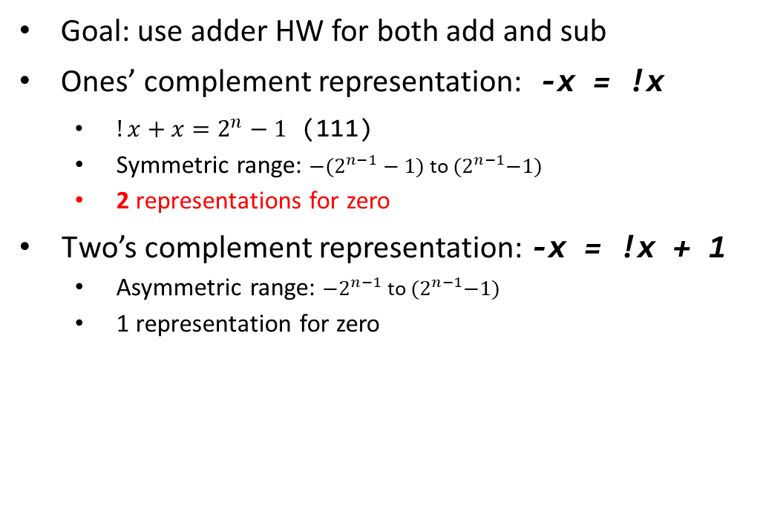
Representation of negative numbers
Goal: use adder HW for both add and sub
Ones’ complement representation: -x = !x
$!x+x=2^{n}−1$ (111)
Symmetric range: ${−(2}^{n−1}−1)$ to ${(2}^{n−1}−1)$
2 representations for zero
Two’s complement representation: -x = !x + 1
Asymmetric range: ${−2}^{n−1}$ to ${(2}^{n−1}−1)$
1 representation for zero
0
0
-1
000
+1
-0
111
001
-2
110
010
+2
+1
101
011
-3
100
+3
-2
-4

Slide 14
Example of subtraction
0
Example: 2 – 3 = ?
2 – 3 = 2 + (−3)
2 + (−3) = 010 + 101 = 111
111 = −1
-1
000
+1
111
001
-2
110
010
+2
0
-1
000
+1
101
011
+3
111
001
-3
100
-4
-2
110
010
+2
0
101
011
+3
-1
000
+1
-3
100
111
001
-4
-2
110
010
+2
101
011
+3
-3
100
-4

Slide 15
Overflow
Example: −2 – 3 = ?
−2 – 3 = −2 + (−3)
−2 + (−3) = 110 + 101 = 1011
011 = 3 → Overflow ☹
Overflow conditions
negative + negative = positive
positive + positive = negative
0
-1
000
+1
111
001
-2
110
010
+2
0
-1
000
+1
101
011
+3
111
001
-3
100
-4
-2
110
010
+2
0
101
011
+3
-1
000
+1
-3
100
111
001
-4
-2
110
010
+2
101
011
+3
-3
100
-4

